Slide 1
d₂p Antimicrobials CPST
July 2019
Copyright Symphony Environmental

Slide 2
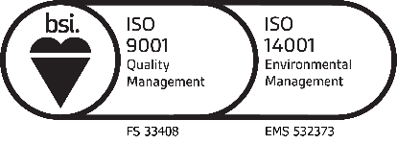
Company Overview
Symphony Environmental Technologies Plc
A British Public Company
Established in 1995 – 35 direct staff
Global Brands including d₂w, d₂p, d₂c and d₂t
The London Stock Exchange Listing since 2000 – LSE: SYM (LON)
More than 200,000 tonnes treated yearly and in nearly 100 countries
ESMA, SASO Quality Marks and ECO label
High-Tech test facilities in Symphony’s own laboratory
Symphony is ISO:9001 and ISO:14001 accredited
Partner in the EU Oxomar Project
d2w is the only Oxo-biodegradable additive with the Internationally-recognised ABNT Eco-Label for environmental quality
Copyright Symphony Environmental

Slide 3
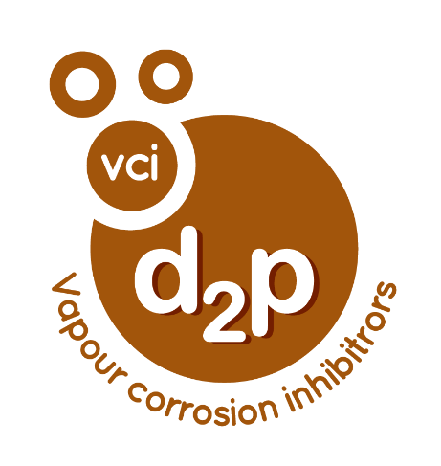
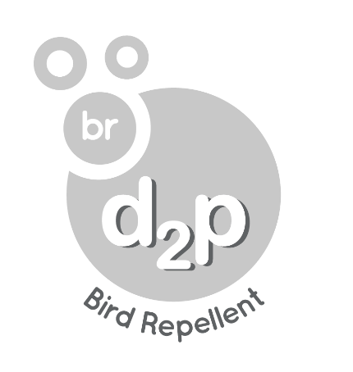
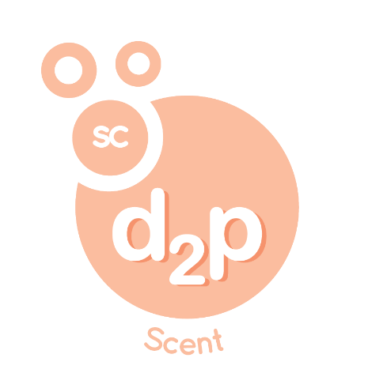
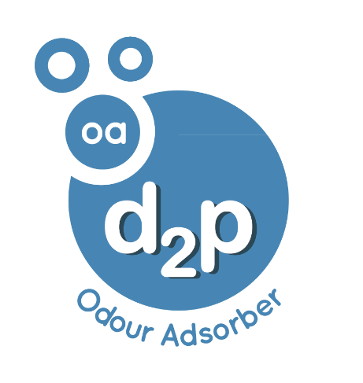
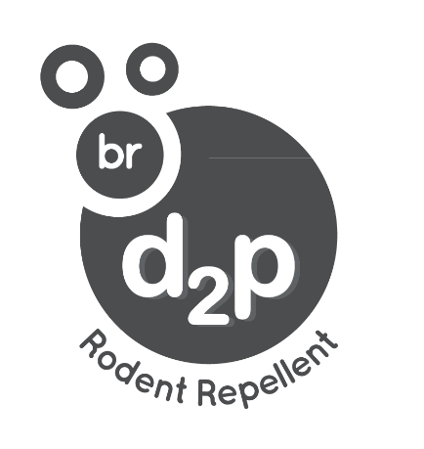
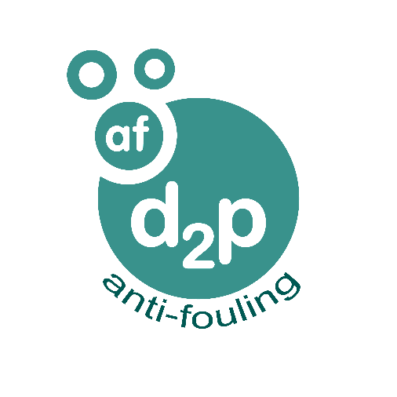
Symphony Environmental Technologies
Copyright Symphony Environmental

Slide 4
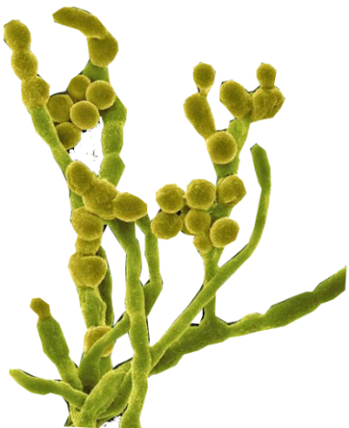
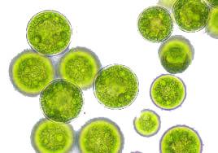
Introduction to d₂p Antimicrobials
d₂p Antimicrobials offers protection from bacteria (both Gram + and Gram -) & fungi (fungi, molds, yeasts, mildew)
An Antimicrobial agent either kills (bactericide, fungicide, algaecide) or retards the growth of microbes (bacteriostat, fungistat)
Plastics play a major role in our lives today and are found abundantly in our everyday lives
Storing food in plastic packaging or using certain products (clothing materials, footwear, etc.) for a prolonged period, promotes the growth of harmful bacteria and fungi
Contamination problems are increasing with escalating cases of pathogenic diseases
Use of antimicrobials can help kill or control the growth of harmful microorganisms
Bacteria
Algae
Yeasts
Fungi, Moulds &
Mildew
Copyright Symphony Environmental

Slide 5
Characteristics
Three families of Antimicrobial Masterbatches/additives: 979XX, 96XXX & 970XX
Testing Methods: ASTM E 2180 , ISO 22196:2011, ASTM G21 , ASTM D5589 & ASTM D7907
d₂p formulations are compatible with Polyolefins, EVA, Styrenics, Polyamides, Polyesters, PVC, PC, PET, etc.
Antimicrobial additives can be supplied in powder form and incorporated with plastic resins during compounding or as a Masterbatch during extrusion, injection, molding, coating, lamination, woven and nonwoven applications
Copyright Symphony Environmental

Slide 6
Mechanism of Action
Fungi, Yeasts & Algae (Eukaryotic cell)
Bacteria (Prokaryotic cell)
Plasma membrane function disruption
Interference with iron metabolism
Inactivation of mitochondrial Fe-S loading proteins
Plasma membrane function disruption by interfering with phospholipids
Metal ion chelation
Interference with trans-membrane transport
Copyright Symphony Environmental

Slide 7
d₂p Antibacterial
d₂p 96000 series are Masterbatches for Plastic packaging applications. They have been designed to improve performance of the plastic product by inhibiting growth of bacteria - both Gram(+) and Gram(-) in both food and non-food contact applications
Easily added in the manufacturing stage: at addition rates between 1% and 4 %
Flexible design of additive to meet the anti-bacterial effect and lifespan as per customers’ application requirements
Compatibility with all polymeric resins and grades (PE, PP, PS, PVC, nylon, PA , ABS, SAN, PC, etc)
Compatible with all plastic processing technologies (extrusion, injection and blow moulding, extrusion and thermoforming, rotational moulding, coatings, multi-layer in flexible and rigid packaging)
Products are registered for use for food-contact applications in both the EU and USA
Copyright Symphony Environmental

Slide 8
d₂p Odour Adsorber
Designed to inhibit the development of undesirable odours, water vapours in plastic products or to prevent spoilage of perishable fruit and vegetables. A safe product widely used as a food additive with an EU “E” code, FDA approved under 21 CFR 182. Can be used for a number of applications including packaging, Clothing & Footwear, household appliance, food containers and medicinal appliances.
A safe product that can be used as a general deodorizer and to combat moisture, mould and mildew. It can be used in powder form or incorporated into plastic Masterbatch. The product can also be used in packaging in a sachet
The product is available for use in PE, PP, EVA, PS, PET and ABS
Copyright Symphony Environmental

Slide 9
Odour Adsorber Mechanism
d2p Odour Adsorbers have microporosity with the diameter in the range of 3 - 5 Å. By selecting the right porosity and combining it with the length of pores, density of material and final concentration in the plastic material, Symphony produced Odour Adsorbers with high efficiency.
The small and uniform holes are very selective in adsorption which allows only a certain size of molecules to be adsorbed (e.g. the hydrocarbons that generate certain types of odour, ethylene, propylene and water vapour). Molecules that are small enough to pass through the pores are adsorbed, while larger molecules are not.
Copyright Symphony Environmental

Slide 10
Ethylene Adsorber/Odour Adsorber Test Results
Product code | Application | Test/Result
96522 96550 | Sealed Containers | An independent 3rd Party Lab test: 4 experiments were carried out to test Ethylene Adsorption by d₂pEA Powder and d₂pEA PE film samples. The results found that more than 90% of Ethylene was adsorbed within 24/48 hours.
Copyright Symphony Environmental

Slide 11
d₂p AM Migration
Standard Result
Submitted Samples As Per applicant’s request with reference to European
Commission Regulation No. 10/2011
- Overall Migration Test Pass
As Per Applicant’s Request With Reference To European
Commission Regulation No. 10/2011
- Specific Migration of Heavy Metal Test Pass
As Per applicant’s request with reference to European
Commission Regulation No. 10/2011
- Specific Migration Of Primary Aromatic Amines Test
Pass
Test For F.D.A. Regulation On Polyethylene
- As Per U.S. 21 CFR Part 177.1520 Clauses (c)(2.1) And (d)
Pass
Copyright Symphony Environmental

Slide 12
Migration Test Conditions
Test Item | 1. Overall Migration Test
Condition | 40℃ for 10 Days
Food Simulant | 3% Acetic Acid
Test Item | 2. Specific Migration Test (Heavy Metals)
Condition | 50℃ for 10 Days
Food Simulant | 3% Acetic Acid
Test Item | 3. Specific Migration Test (Primary Aromatic Amines)
Condition | 50℃ for 10 Days
Food Simulant | 3% Acetic Acid
Copyright Symphony Environmental

Slide 13
USA Regulatory Compliance
The active in d₂p AM 97000 MBs is registered with the EPA for the control of fungi and bacteria causing stain, odour and or degradation of physical properties in polymers used to manufacturing or coating in food contact finished articles.
Copyright Symphony Environmental

Slide 14
FDA Regulation
Polyethylene
As per the U.S. 21 CFR food and drug administration part 177.1520 clauses (c)(2.1) and (d)
Test Sample: Plastic plaque
Test Item Result Limit
(A) Density 0.934 0.85 – 1.00
(By Sink-Float Method)
(B) Maximum Extractable Fraction In N-Hexane 0.22 %(W/W) 5.5 %(W/W)
(C) Maximum Extractable Fraction In Xylene 1.66 %(W/W) 11.3 %(W/W)
Remark : % = Percentage based on the residue by weight
CONCLUSION: The Migration Studies, show no migration of the active substance in aqueous food simulants or powerful solvents
Copyright Symphony Environmental

Slide 15
Antimicrobial Test Methods
ISO 22196:2011 – Quantitative Measurement of anti-bacterial activity on plastic and other non-porous surfaces
ASTM G21 – Determining the resistance of synthetic polymeric materials to fungi
ASTM E2180 - Standard Test Method for Determining the Activity of Incorporated Antimicrobial Agent(s) In Polymeric or Hydrophobic Materials
ISO22196:2011 (Modified & Adapted) For Anti-Algae performance
ASTM D5589 - Standard for Anti Algae for Determining the Resistance of Paint Films and Related Coatings to Algal Defacement
ASTM D7907 - Standard Test Methods for Determination of Bactericidal Efficacy on the Surface of Medical Examination Gloves
Copyright Symphony Environmental

Slide 16
Latest d2p AM Test Results
Product code | Application | Certification and Result | Regulatory
97941/D (PE) 97041/D (PP) 97051/D (PVC) | NSF Drinking water pipe & fittings Certification | AF tested as per ASTM E2180-07 PASSED with 99.99% reduction AF tested as per ASTM G21-13 PASSED with 0 mould growth AB Tested as per ISO 22196:2011 > 99.999% | NSF ANSI 61- drinking water system components – health effects
96703 & 96704 | Bread packaging | AF tested as per ASTM E2180-07 PASSED with 99.99% reduction AB Tested as per ISO 22196:2011 Log: > 5 PASS | EU BPR Approval for Product Types: 2, 4, 5, 7, 9 Has US FDA FCN, EPA Compliance
97010 | Gloves | AF tested as per ASTM G21-13 PASSED with 0 mould growth- In Latex, PVC & Silicone AF tested as per ASTM E2180-07 PASSED with 99.99% reduction - In Latex and Nitrile AA (Anti-Algae) tested as per ASTM D5589, PASSED with 0 Algae growth - In Latex and Nitrile AB Tested as per ISO 22196:2011 > 99.999% reduction - In Silicone, Nitrile, Rubber & Polyurethane Early Kill Rate passed as per ASTM D7907 – 96.76% reduction in 2 mins vs Control = 0% reduction - Tested by Antimicrobial Test Laboratory, Texas | EU BPR Approval for Product Types: 2, 6, 7, 9, 10, 21 EPA Label for Non-Food Contact Applications EPA Label for Repeated Use Food Applications
97040 97041-i | Single use packaging for FDA food contact approval | PASSED Migration test as per FDA Protocols - Smithers Pira UK, LOD = 100 μg/kg PASSED Migration test as per FDA Protocols - Jordi Labs USA, LOD = 50 μg/kg | FDA Protocols for food contact
97966, 97967, 97931 | Food Packaging | AF tested as per ASTM G21-13 PASSED with 0 mould growth | Approved by FDA Approved under EU 10/2011 All chemicals have full REACH Registration
Copyright Symphony Environmental

Slide 17
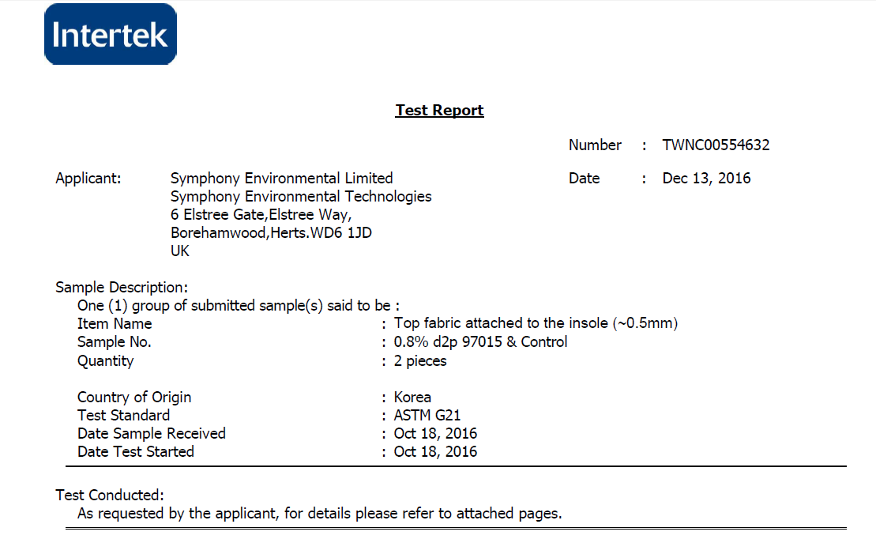
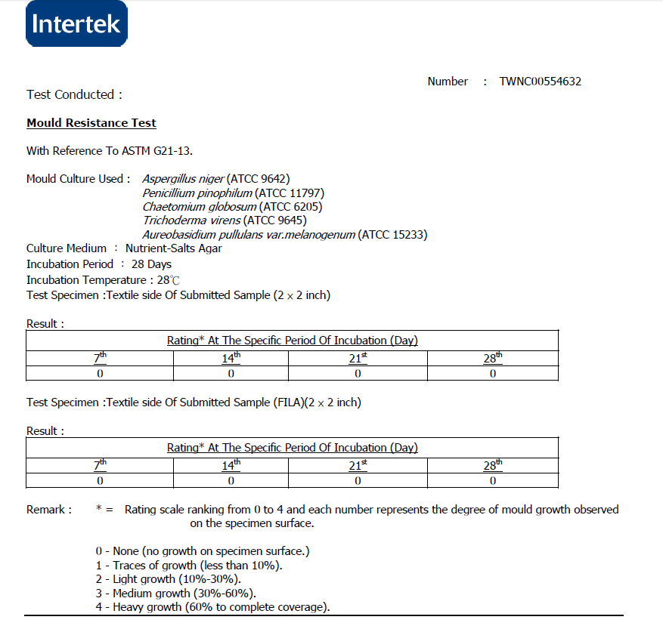
Independent ASTM G21-13 (Anti-Fungal) Lab Test Result for Insoles - 0.8% d2pAM 97015
0% FUNGAL GROWTH ON SAMPLE
Copyright Symphony Environmental

Slide 18
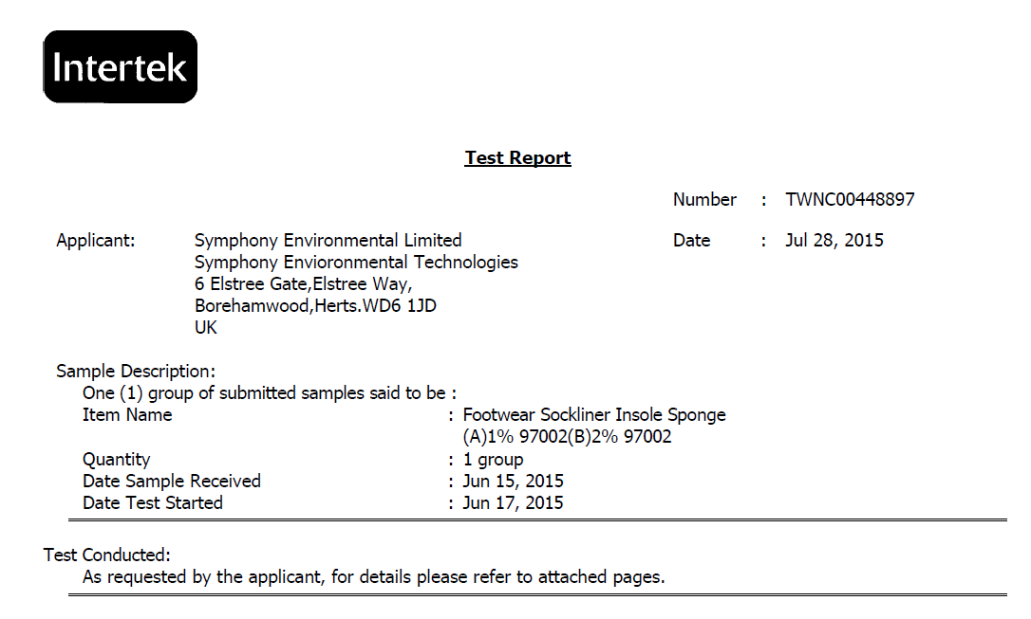
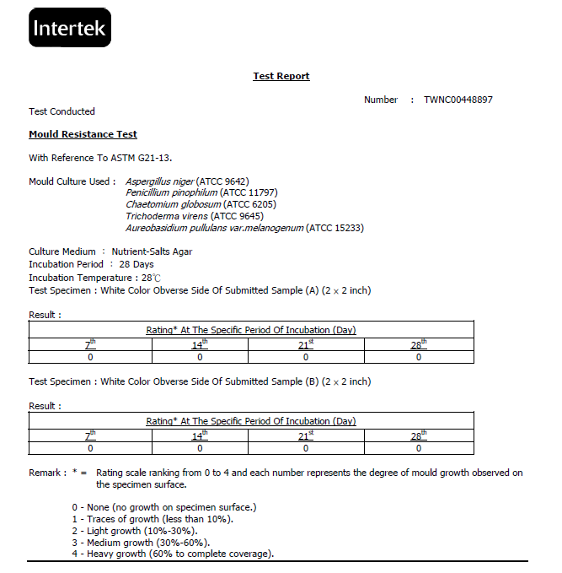
Independent ASTM G21-13 (Anti-Fungal) Lab Test Result for Footwear Sockliner Insole Sponges - 1% & 2% d2pAM 97002
0% FUNGAL GROWTH ON SAMPLES
Copyright Symphony Environmental

Slide 19
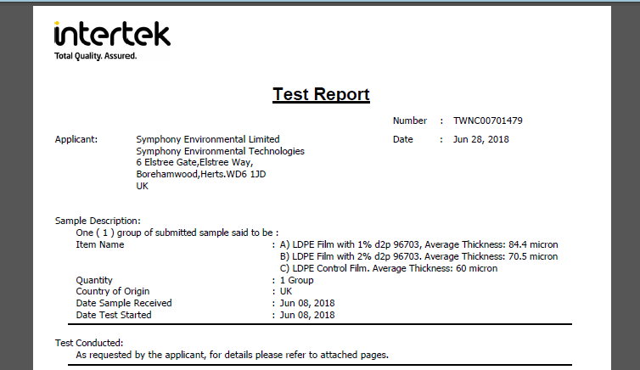
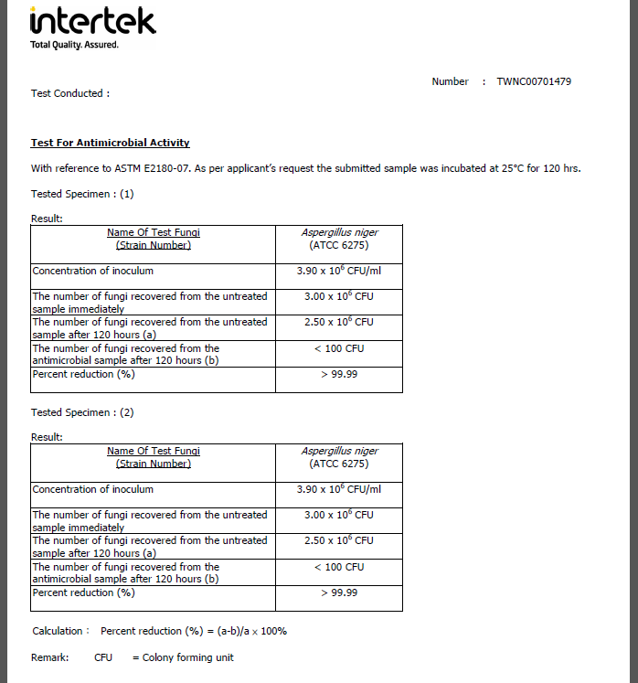
d₂p AM 3rd Party Test Result by Intertek
Tested as Per ASTM E2180-07 (Anti-fungal testing)
At 1% and 2%
Tested against A.niger Fungus
Achieved >99.99% in fungal reduction at both concentrations
Copyright Symphony Environmental

Slide 20
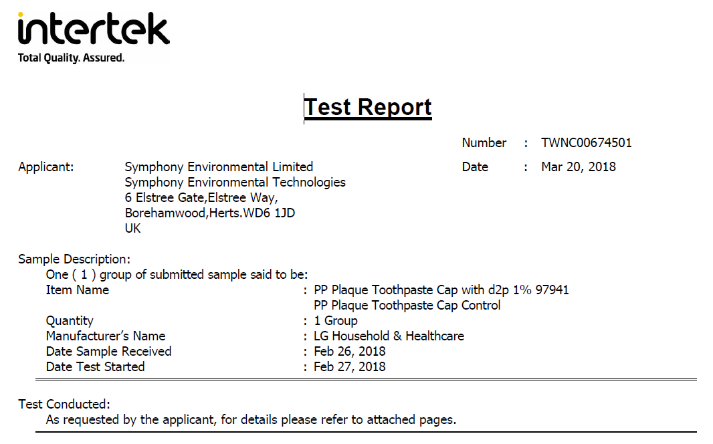
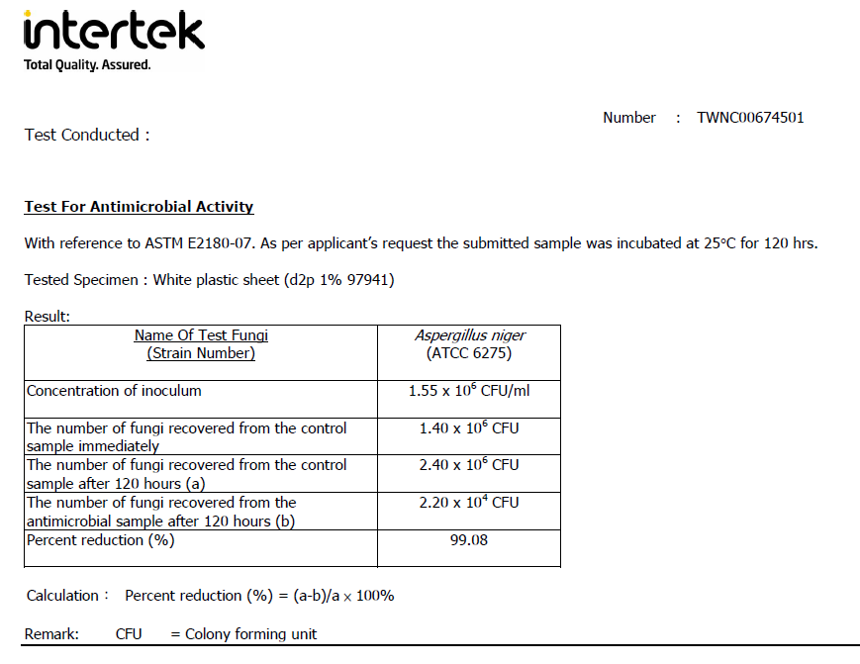
Independent ASTM E2180-07 (Anti-Fungal) Lab Test Result for Plaque Toothpaste Cap – 1% d2pAM 97941
99.08% Fungal Reduction

Slide 21
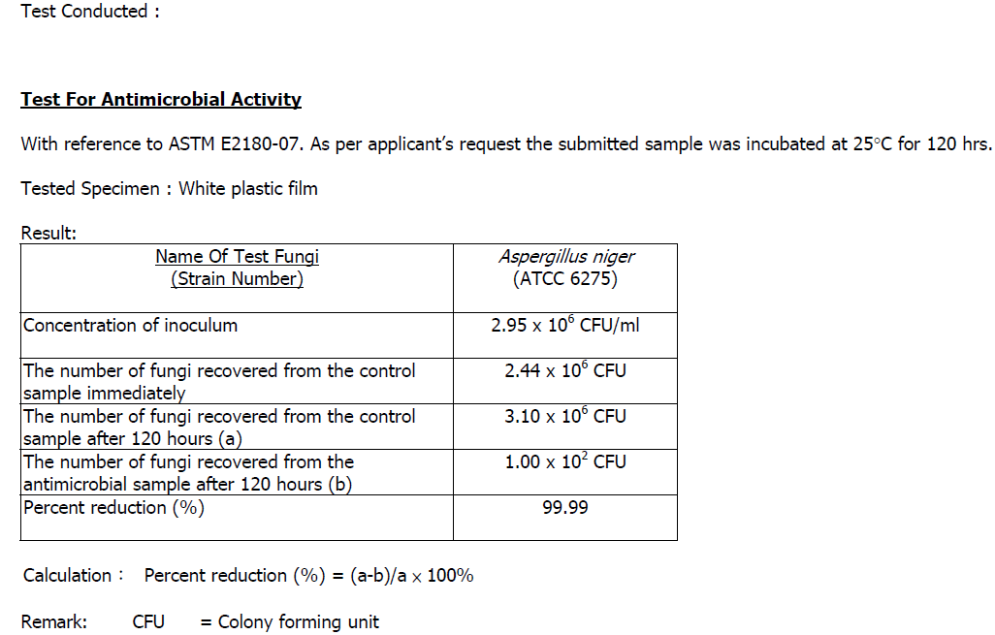
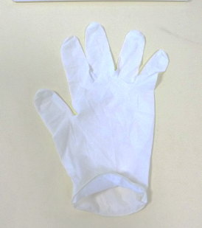
Independent Lab Test Result for Latex Exam Glove
with 0.75% d2p 97010 (Fungal)
99.99% of Fungal Reduction Achieved
Copyright Symphony Environmental

Slide 22
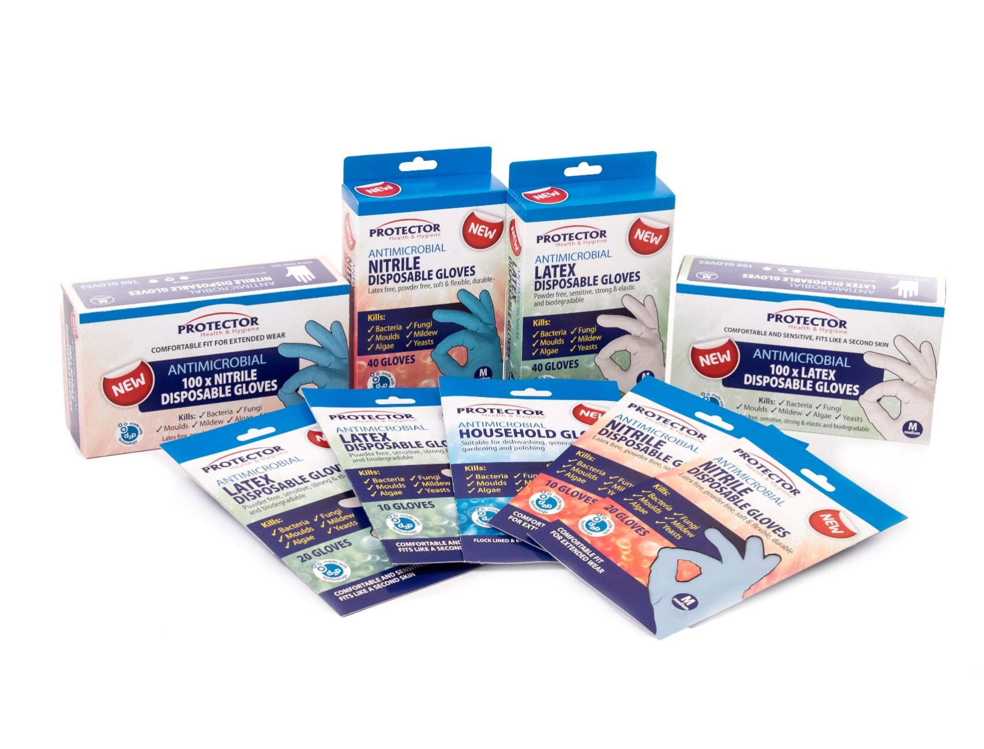
Copyright Symphony Environmental

Slide 23
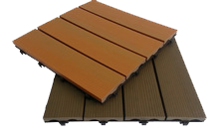
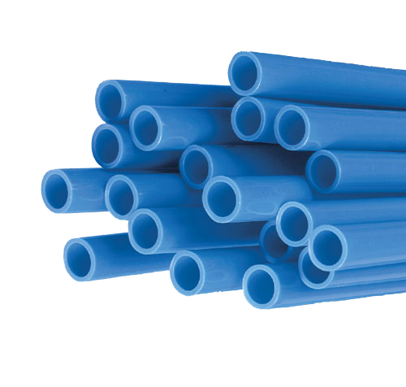
PRODUCT TEST EXAMPLES
Biological efficacy Fungicidal (ASTM E2180)
Nearly 100% reduction of fungal growth!
Copyright Symphony Environmental

Slide 24
Biological efficacy Algaecidal (modified ISO 22196)
Untreated
control
Protected with 1%
d₂p AM
Protected with 2%
d₂p AM
Nearly 100% reduction of algal growth!
Copyright Symphony Environmental

Slide 25
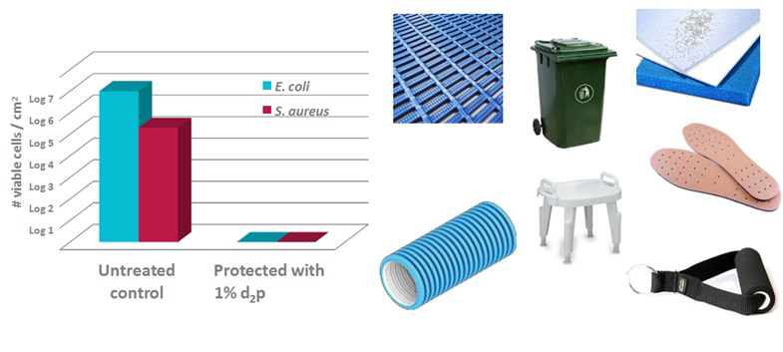
Biological efficacy Bacterial (ISO 22196)
Log 5 or 6 reduction in bacteria! (99.9999% Kill rate)
Copyright Symphony Environmental

Slide 26
d₂p Antimicrobial Protection in Footwear
d₂p Am can be used in footwear to control and kill the microbes which grow due to the constant skin contact with the plastic material in footwear
It can be either used on its own or in combination with a d2p Odour Adsorber
Suitable for use in all plastic processing technologies: Extrusion, injection and rotational moulding, coating, lamination, woven and non-woven
The product is non-toxic, odourless and heat stable
Extends shelf life and helps reduce decay, mould, discoloration and wilting
More competitive product compared to ordinary footwear
Copyright Symphony Environmental

Slide 27
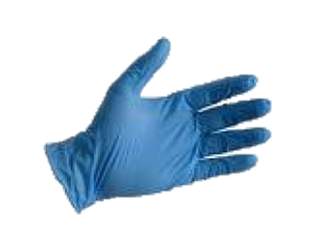
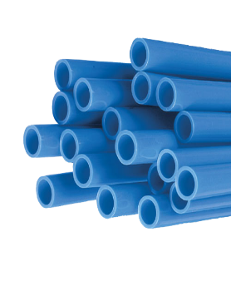
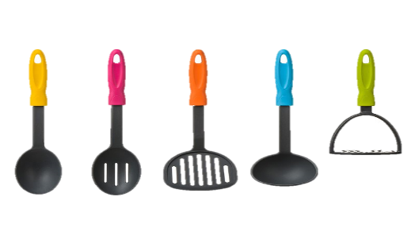
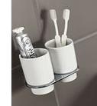
Applications
Antimicrobial Food & Drinking Water Contact Applications (Repeated Use) | Antimicrobial Non-food Applications | Antibacterial Food Contact Applications | Antibacterial Non-food Contact Applications
Bakery packaging Food, Fruit & Veg packaging Drinking water pipes and fittings Kitchen utensils Food processing equipment (e.g. Conveyor belts) Shopping bags Gloves | Footwear, clothing and accessories Agriculture Electronics Home Sanitary Transportation | Food Packaging Kitchen utensils Disposables Food storage containers Wrapping film Refrigerator parts | Gloves Handles All Bathroom accessories Protective Covers Bins and Bags Storage Units
Copyright Symphony Environmental

Slide 28
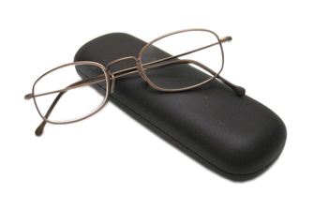
Thank you for your attention
Copyright Symphony Environmental

